Slide 1
THE STOCK BOT
NEURAL NETWORKS AND REINFORCEMENT LEARNING
Tensorflow Keras
Abhinav Kolli
UTD AI Research

Slide 2

Context
Stock Market: The aggregation of buyers and sellers of stocks, which represent ownership claims on businesses.
Stock: A fractional ownership of the corporation in proportion to the total number of shares.
Many people invest in these individual stocks based on a variety of factors.
Investors identify trends based on these factors to know when to buy and sell.
With new advancements in technology, companies and investors are looking towards utilizing AI to identify future stock trends.

Slide 3
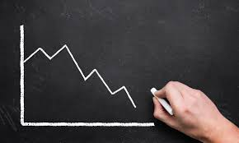
Problem
In the past, people had to manually identify trends and mathematically compute them.
ARIMA Models: Autoregressive integrated moving average
Disadvantages:
Only univariate data such as closing prices
Only averages; Not helpful for future trends
With the help of neural networks and model learning, AI can help predict trends much faster than us.
Goal (2-Step Process):
Construct a Multivariate Stock Prediction Neural Network that can predict future stock trend movement.
Utilize Reinforcement Learning to show a simulation of buying and selling stocks.

Slide 4
CONSIDERED APPROACHES
LSTM RNN
1D CNN WITH BASIC GRU
LOGISTIC REGRESSION
Deep Q-learning

Slide 5
Creating Forecast Model
01
04
Research Features & Gather Data
Build LSTM RNN
Model & Train It
02
05
Develop ARIMA Model
for Comparison
Test Model &
Evaluate Results
03
06
Pre-Process Data &
Find Correlations
Tune Hyperparameters

Slide 6
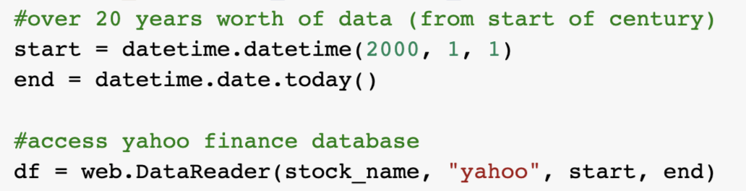
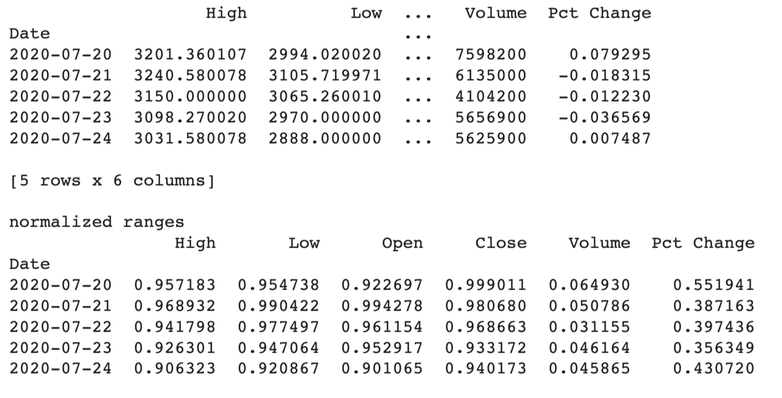
Gathering Data/Features
Uses Yahoo Finance DataReader to access financial data.
For our program, just input ticker (AMZN) to run.
A data frame will be used to read data from database.
Features planned for use:
Close, high, open, low values
Adj close and volume
Pct Change of close values
Moving averages (ARIMA) for 10, 50, and 100
Total Planned: 10 features
Due to different ranges, all features were
normalized from ranges 0 - 1 for easier training.

Slide 7
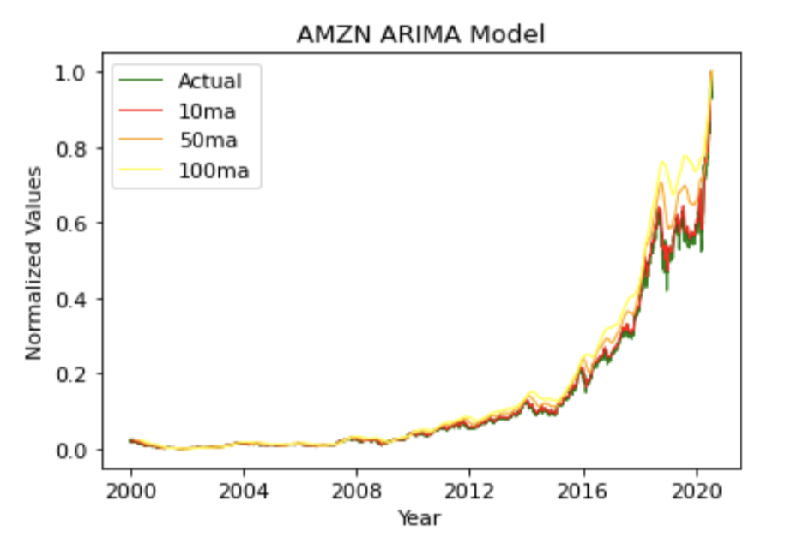
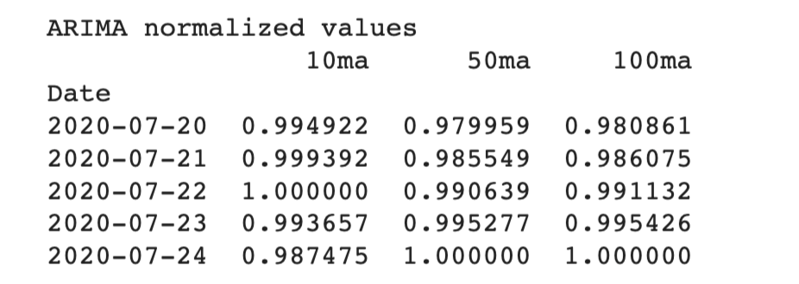
ARIMA Models
ARIMA Models were used for testing comparison and accuracy
A simple moving average (SMA) is the most basic MA, which is just a straight calculation of the mean price of a set of values over a given time periods.

Slide 8
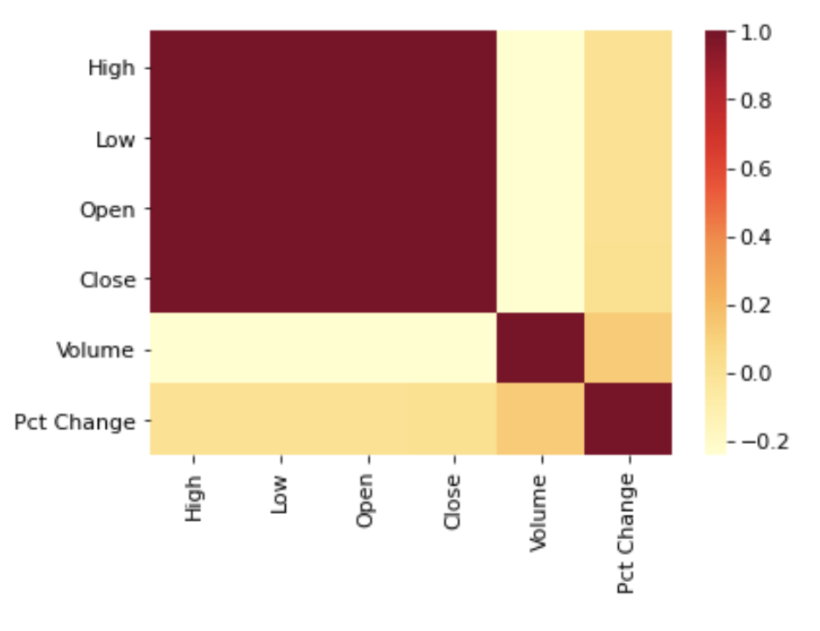
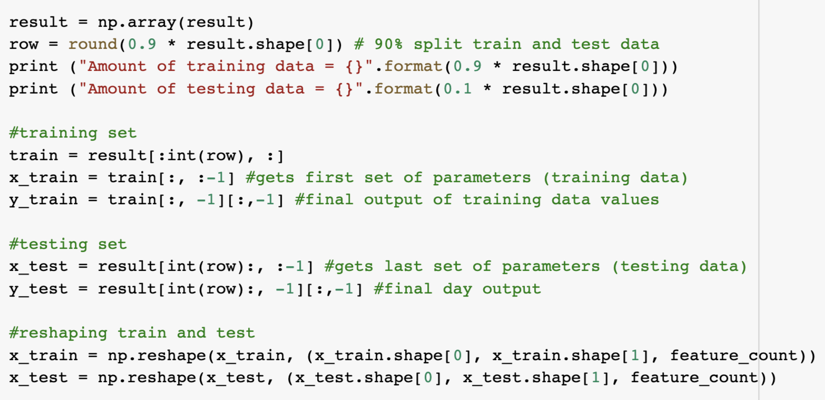
Pre-Processing Data
Find correlations between each of the features.
Final four features: high, low, open, and close values.
Split the data into 90% training and 10% testing
Split here to ensure at least 400 testing days.
Hyperparameters for Training:
Decay = 0.2
Dropout Rate = 0.5
Epoch = 200
Window of Days = 30

Slide 9
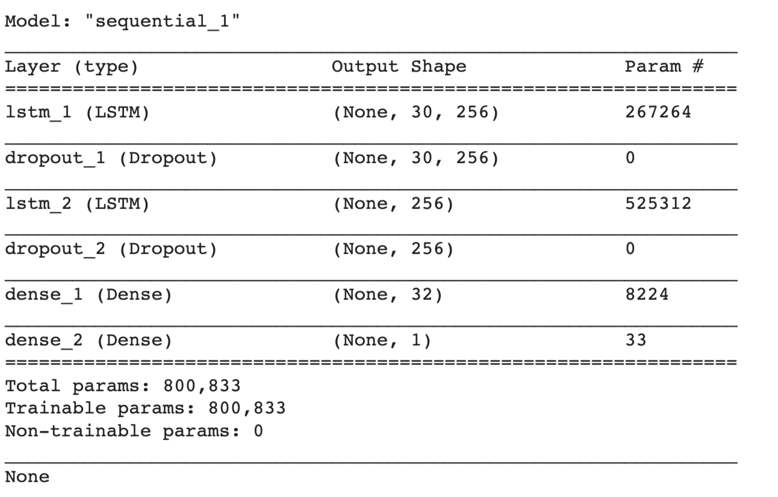
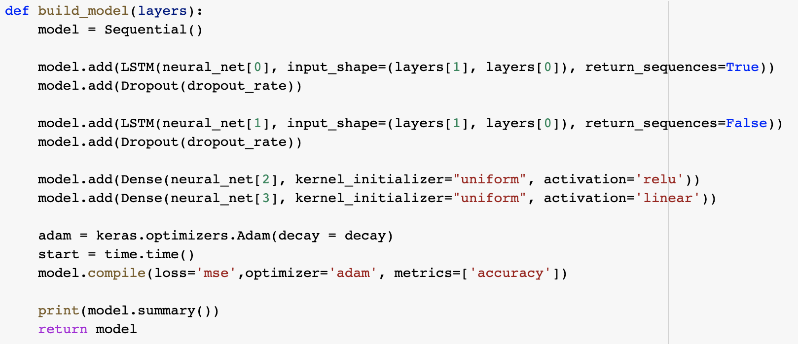
Building and Training LSTM
Stacked LSTM RNN Model:
Had two lstm and dropout layer pairs
Used activation functions: relu and linear
Compiled with adam optimizer and used decay parameter to reduce overfitting

Slide 10
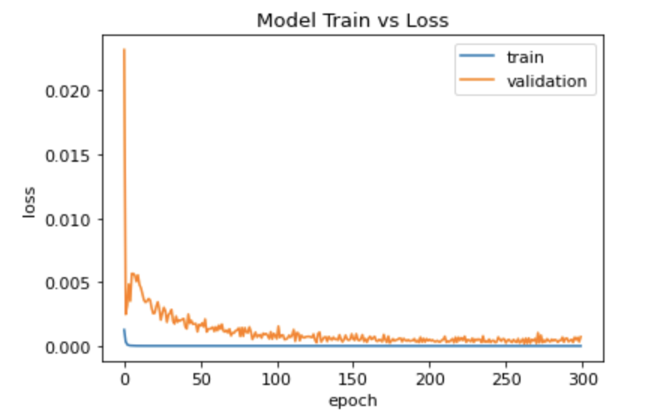
Testing LSTM RNN Model
Results:
After fitting model, I evaluated the training and testing performance using MSE and RMSE.
Constructed a train vs testing loss graph.
The model’s training and testing performance each reach equilibrium at baseline, meaning model had high accuracy and no overfitting.
Prediction:
After checking for accuracy, used model.predict(X_test) to get final prediction for the tested business days.
Finally, denormalized all the ranges back to their original values.

Slide 11
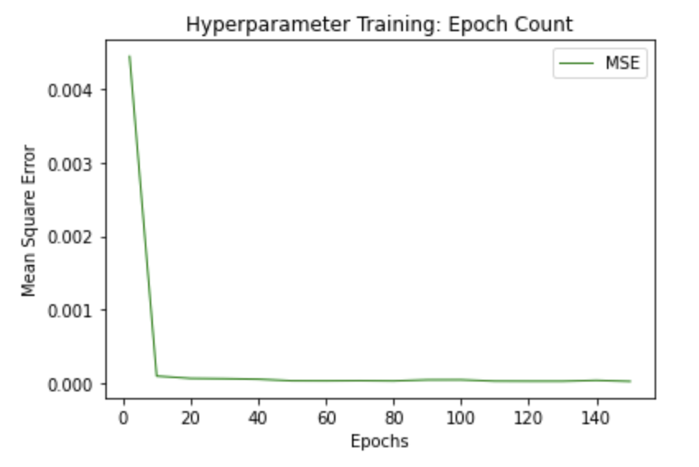
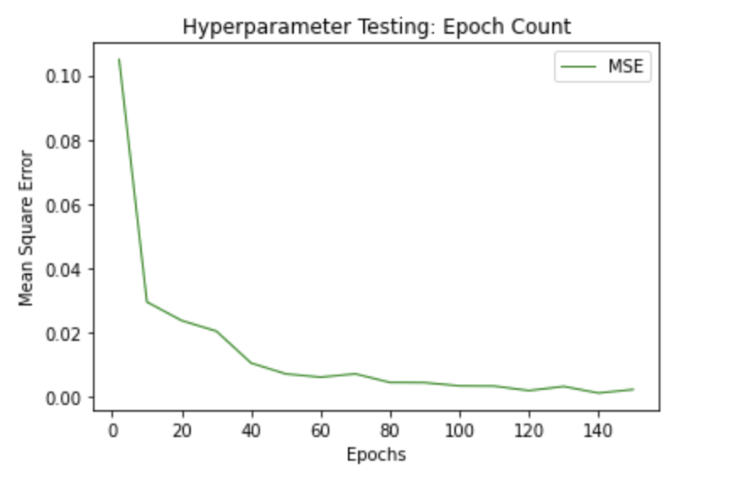
Tune Hyperparameters
Epoch Count
epoch_tests = [2,10,20,30,40,50,60,70,80,90,100,110,120,130,140,150]

Slide 12
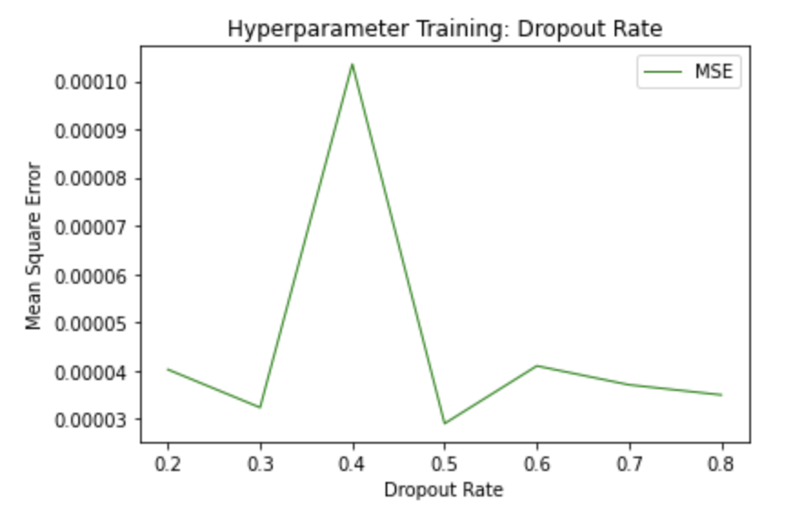
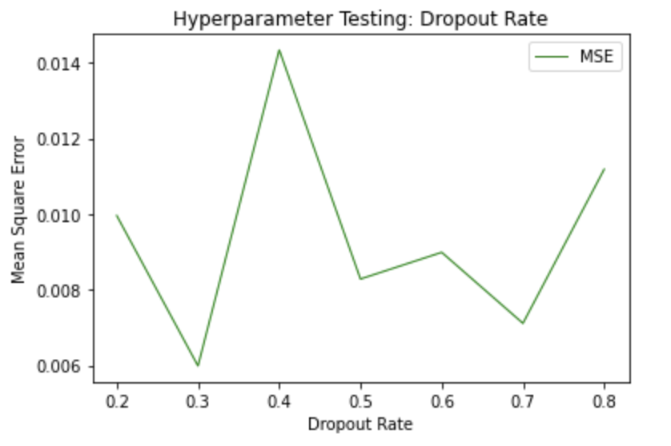
Tune Hyperparameters
Dropout Rate
dropout_tests = [0.2, 0.3, 0.4, 0.5, 0.6, 0.7, 0.8]

Slide 13
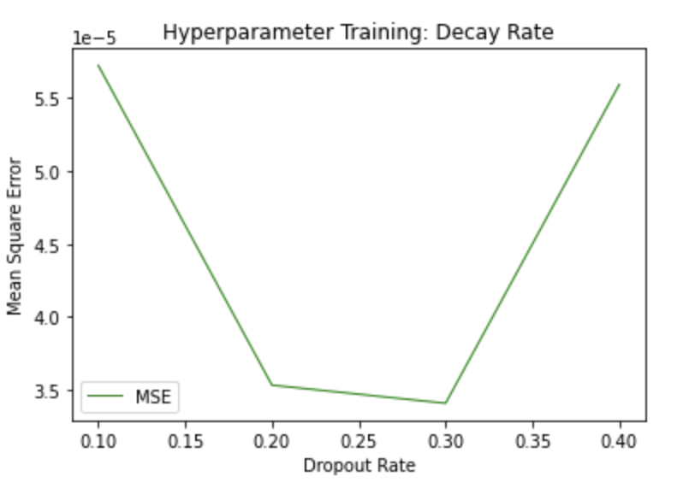
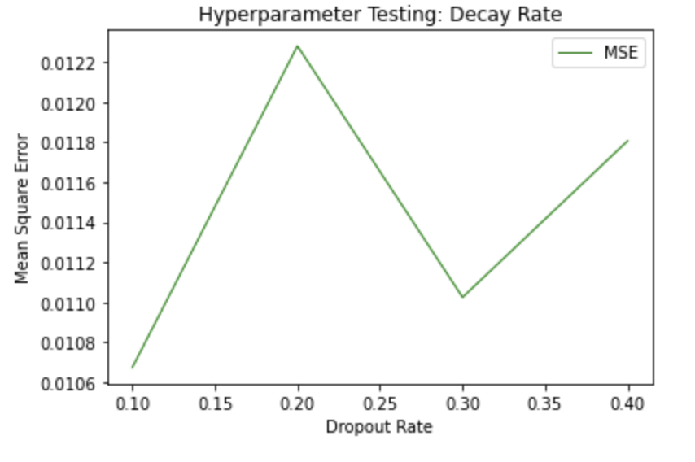
Tune Hyperparameters
Decay Rate
decay_tests = [0.1, 0.2, 0.3, 0.4]

Slide 14
LIVE DEMONSTRATION
LSTM RNN Forecast

Slide 15
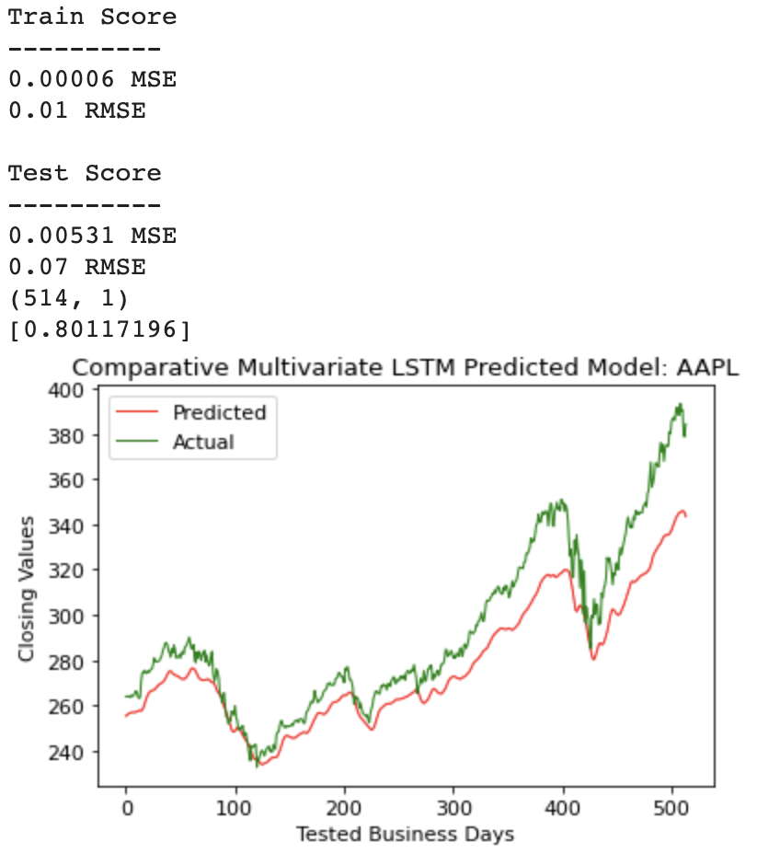
Case Example 1: AAPL

Slide 16
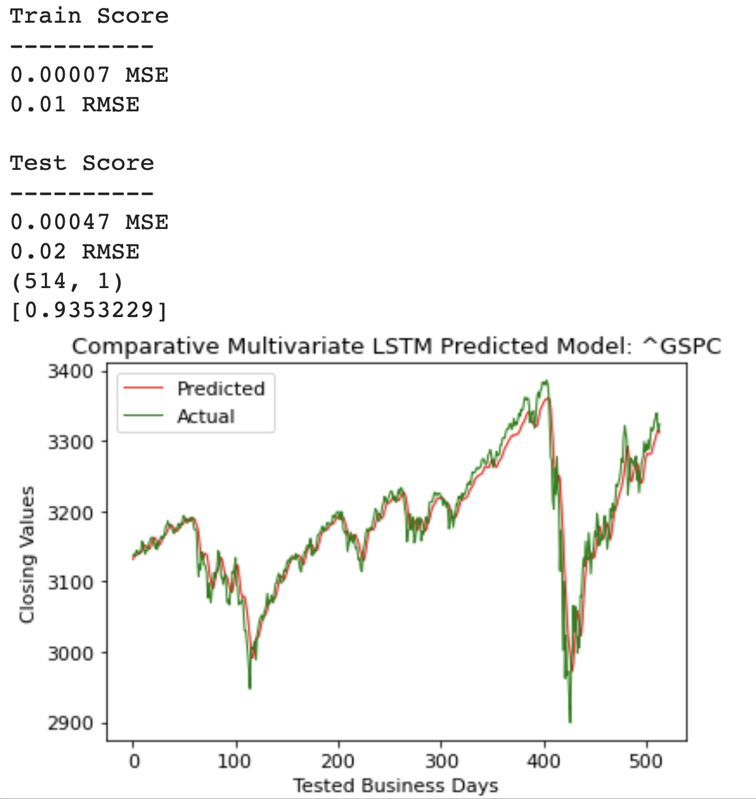
Case Example 2: ^GSPC

Slide 17
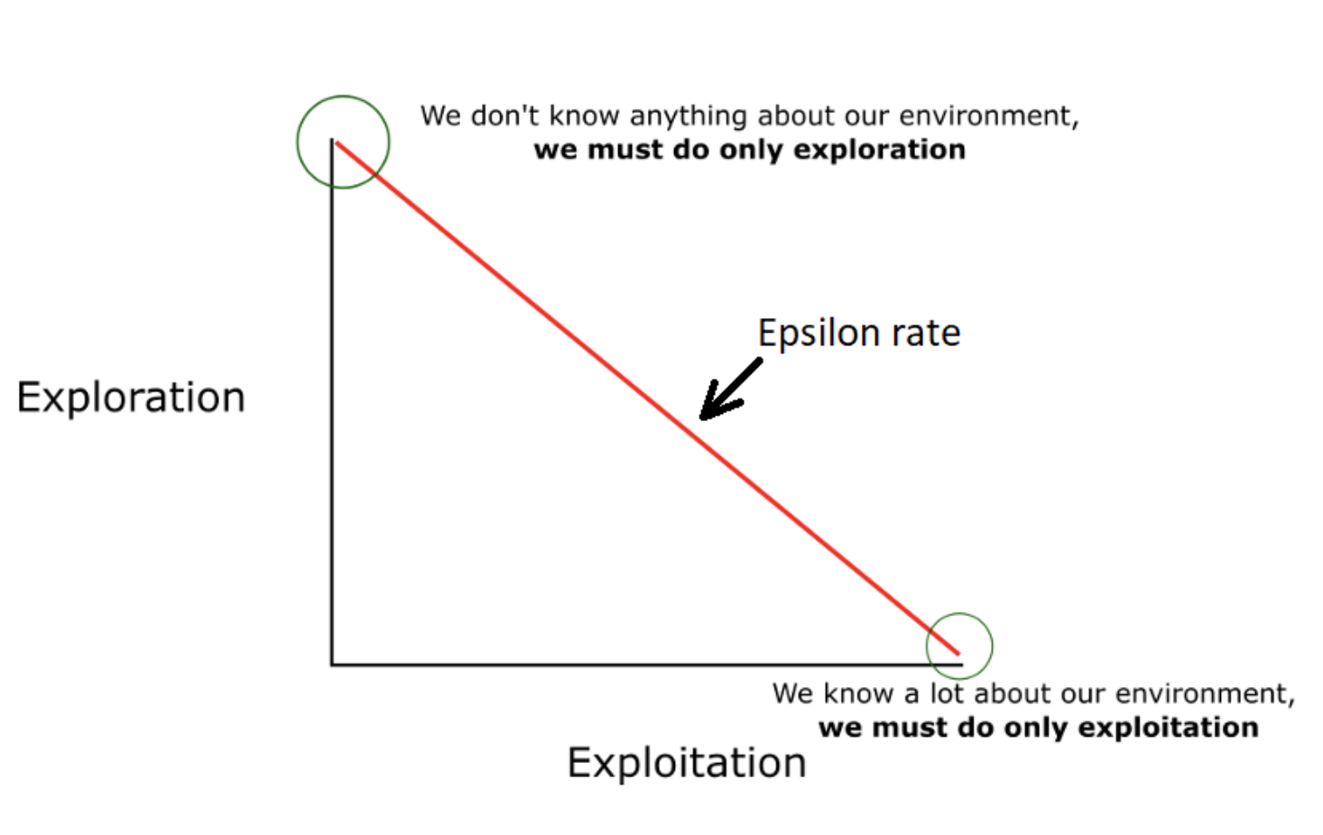
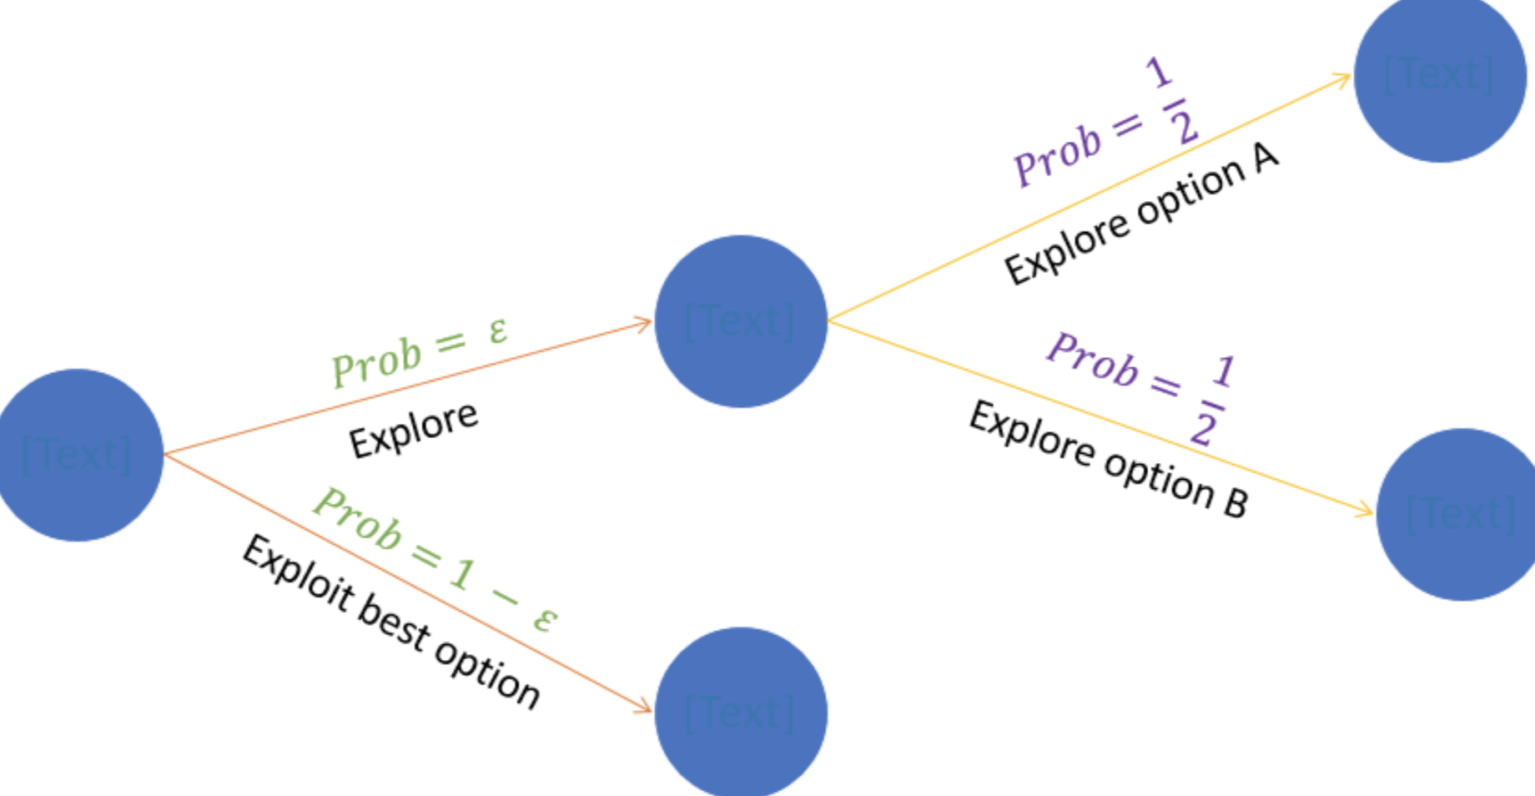
Simple DQN: Epsilon-Greedy
After getting the predicted model from the LSTM RNN, now I want another model that can read this data and output when to buy and sell stocks using an algorithm.
This requires reinforcement learning! The DQN is reinforcement learning that predicts a Q-value of a state using a reward system.
The model trains for lots of iterations and updates its memory on the rewards.
Epsilon-Greedy Algorithm:
It picks the move with the biggest gains.
Makes use of the exploration-exploitation

Slide 18
Creating DQN Agent
01
04
Read Predicted
Close Values
Run Test And Real-time Report for Each Day
02
05
Build Agent Class
& Methods
Analyze Results and Output Final Data
03
06
Train DQN Agent
Tune Hyperparameters

Slide 19
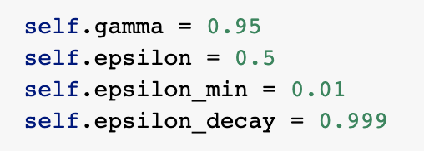
Building Agent
Hyperparameters:
Gamma: Helps with discounting rewards
Epsilon: Initial probability
Min: Minimum exploration probability
Decay: Decay rate of exploration probability
Act Function:
Reduces epsilon progressively as the agent becomes more confident at estimating Q-values.
Get_state Function:
Reports state at that iteration
Replay Function:
Where the model learns and remembers previous experiences to evaluate and make decisions
Updates epsilon overtime

Slide 20
Building Agent
Train Function:
Where the training occurs
Buy Function:
Similar to the train, but it is what the agent runs for testing
Agent Model Infrastructure:
Utilizes dense layer with activation function relu
Has feed dense layers to update training action and validation
Uses Gradient Descent optimizer
Updates cost and value loss

Slide 21
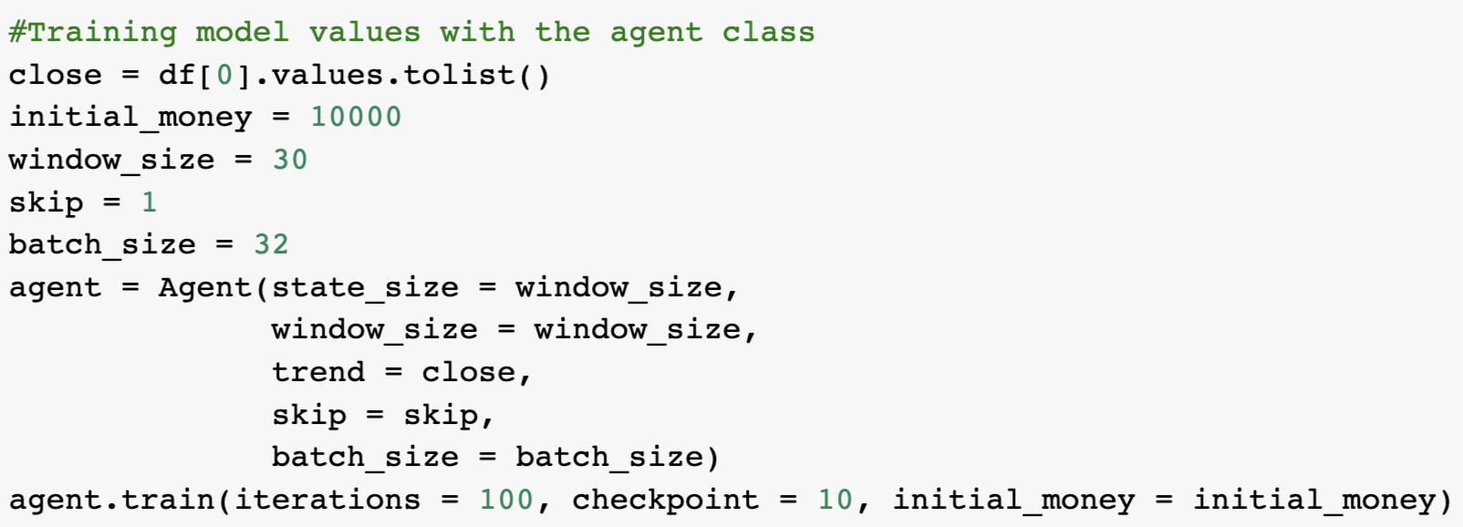
Training/Testing DQN Agent
Training:
Accesses the saved csv file from previous model
Gives model $10000 for investing
Runs Agent Class
100 iterations
Reports every 10 epochs
Testing:
Returns back buy and sell plots, total gains, and investing power of the model.

Slide 22
LIVE DEMONSTRATION
DQN AI Investing Bot

Slide 23
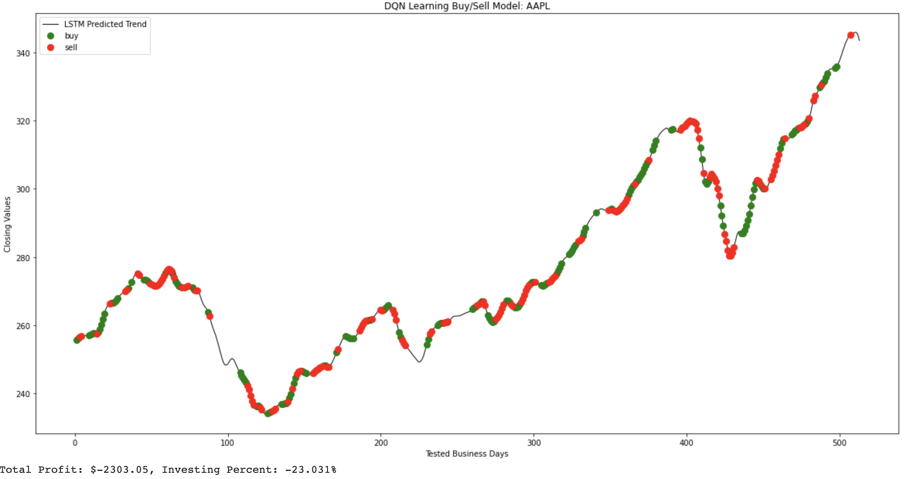
Case Example 1: AAPL

Slide 24
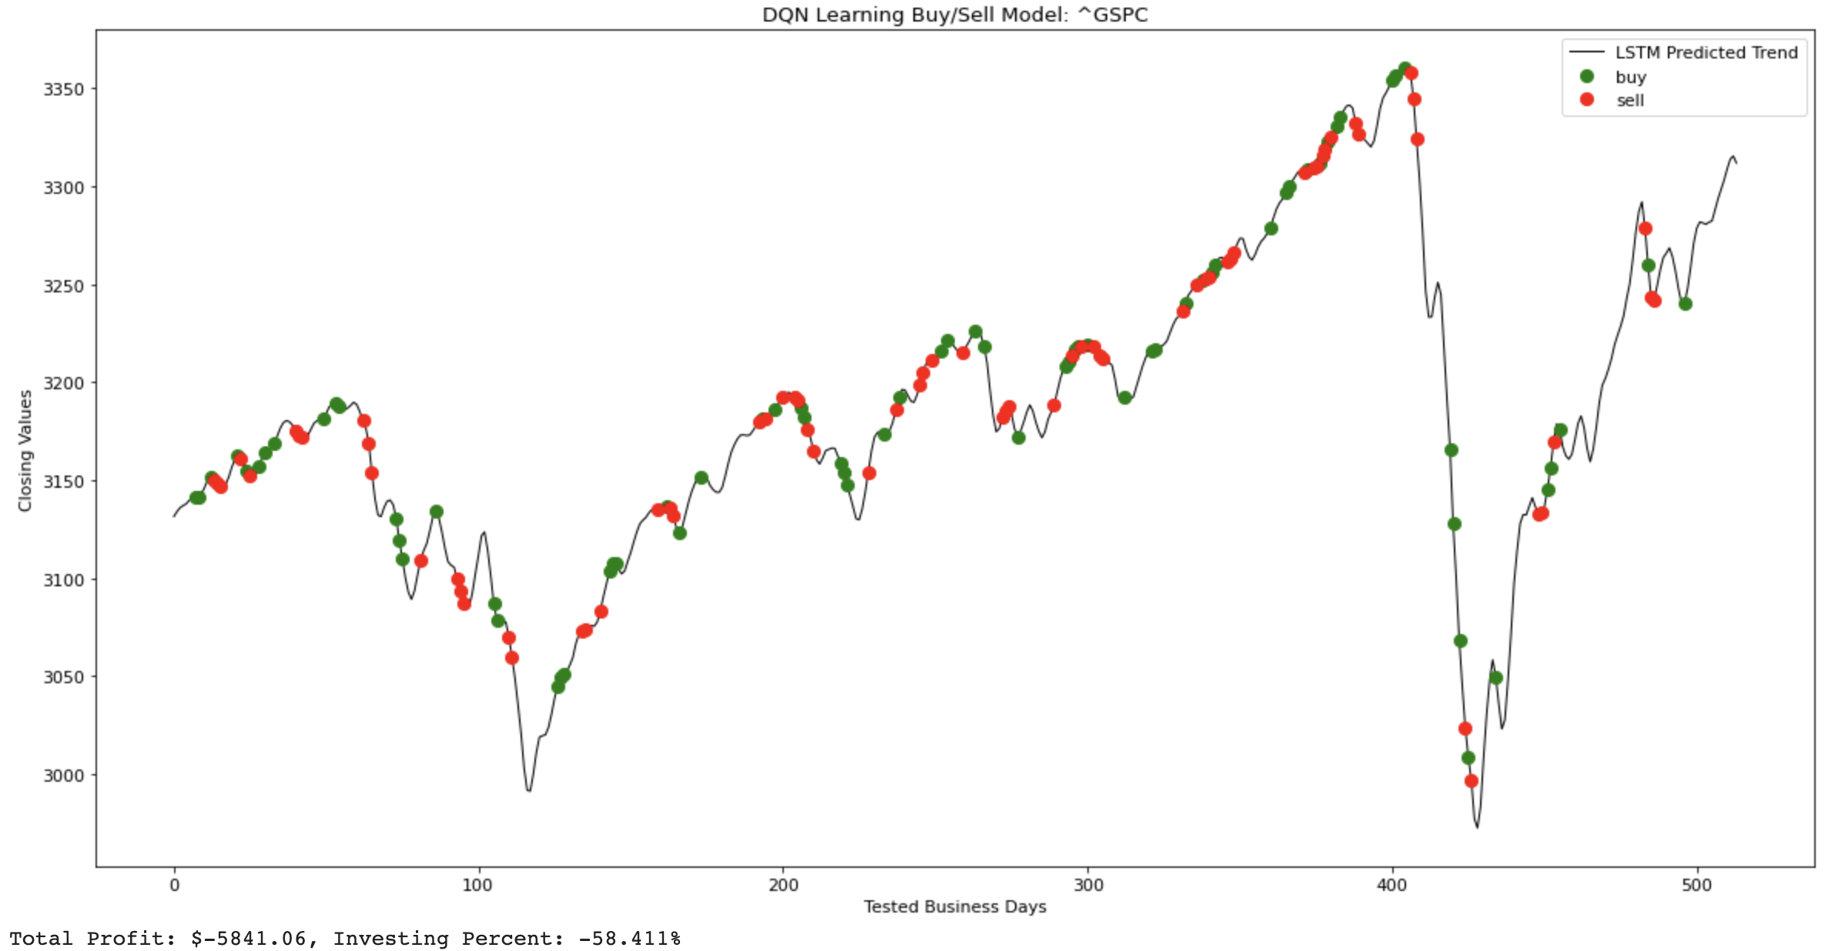
Case Example 2: ^GSPC

Slide 25
SUCCESSES
USES REAL-TIME DATA
FUNCTIONAL LSTM RNN
HIGH ACCURACY
ADAPTABLE TO ANY STOCK
USE OF DQN RL

Slide 26
FUTURE IMPROVEMENTS
IMPROVE GREEDY ALGORITHM
INCORPORATE DDQN
TRY SENTIMENT ANALYSIS
USE ARIMA MODEL FEATURES
RESEARCH NEW FEATURES
TRY FUTURE PREDICTIONS

Slide 27
A SPECIAL THANK YOU TO...
Dr. Nagar, Omeed, Ashutosh, and Dr. Veerasamy for your guidance, expertise, and persistence to teach us this intense and vast field!

Slide 28
CREDITS
K. Soman, V. Sureshkumar, V. T. N. Pedamallu, S. A. Jami, N. C. Vasireddy and V. K. Menon, “Bulk price forecasting using spark over nse data set,” Springer, 2016, pp. 137–146. International Conference on Data Mining and Big Data.
Al-Thelaya, Khaled & El-Alfy, El-Sayed & Mohammed, Salahadin. (2018). Stock Market Forecast Using Multivariate Analysis with Bidirectional and Stacked (LSTM, GRU). 1-7. 10.1109/NCG.2018.8593076.
https://medium.com/@leosimmons/double-dqn-implementation-to-solve-openai-gyms-cartpole-v-0-df554cd0614d
https://github.com/huseinzol05/Stock-Prediction-Models
https://machinelearningmastery.com/dropout-for-regularizing-deep-neural-networks/

